Slide 1
DevOps Training Assignment 1
Learning Topics
1. Learn about CDN, DNS.
2. Learn about TCP/UDP protocol.
3. Create AWS account.
4. Go through all documents shared on Google classroom.
5. Learn about System status check and instance status check.
6. Learn about Port numbers.

Slide 2
What is CDN?
A content delivery network (CDN) refers to a geographically distributed group of servers which work together to provide fast delivery of Internet content. A CDN allows for the quick transfer of assets needed for loading Internet content including HTML pages, javascript files, stylesheets, images, and videos.
The popularity of CDN services continues to grow, and today the majority of web traffic is served through CDNs, including traffic from major sites like Facebook, Netflix, and Amazon.
A properly configured CDN may also help protect websites against some common malicious attacks, such
as Distributed Denial of Service (DDOS) attacks.
Is a CDN the same as a web host?
While a CDN does not host content and can’t replace the need for proper web hosting, it does help cache content at the network edge, which improves website performance. Many websites struggle to have their performance needs met by traditional hosting services, which is why they opt for CDNs.
By utilizing caching to reduce hosting bandwidth, helping to prevent interruptions in service, and improving security, CDNs are a popular choice to relieve some of the major pain points that come with traditional web hosting.

Slide 3
What are the benefits of using a CDN?
Although the benefits of using a CDN vary depending on the size and needs of an Internet property, the primary benefits for most users can be broken down into 4 different components:
Improving website load times - By distributing content closer to website visitors by using a nearby CDN server (among other optimizations), visitors experience faster page loading times. As visitors are more inclined to click away from a slow-loading site, a CDN can reduce bounce rates and increase the amount of time that people spend on the site. In other words, a faster a website means more visitors will stay and stick around longer.
Reducing bandwidth costs - Bandwidth consumption costs for website hosting is a primary expense for websites. Through caching and other optimizations, CDNs are able to reduce the amount of data an origin server must provide, thus reducing hosting costs for website owners.
Increasing content availability and redundancy - Large amounts of traffic or hardware failures can interrupt normal website function. Thanks to their distributed nature, a CDN can handle more traffic and withstand hardware failure better than many origin servers.
Improving website security - A CDN may improve security by providing DDoS mitigation, improvements to security certificates, and other optimizations

Slide 4
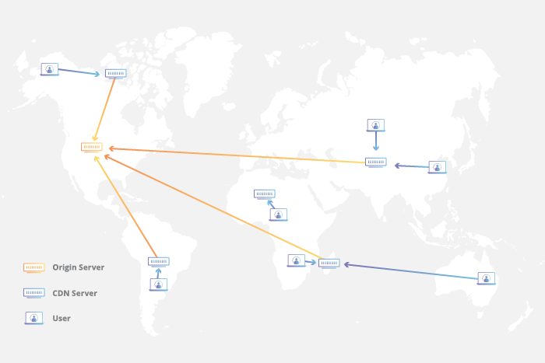
How does a CDN work?
At its core, a CDN is a network of servers linked together with the goal of delivering content as quickly, cheaply, reliably, and securely as possible. In order to improve speed and connectivity, a CDN will place servers at the exchange points between different networks.
These Internet exchange points (IXPs) are the primary locations where different Internet providers connect in order to provide each other access to traffic originating on their different networks. By having a connection to these high speed and highly interconnected locations, a CDN provider is able to reduce costs and transit times in high speed data delivery.
Beyond placement of servers in IXPs, a CDN makes a number of optimizations on standard client/server data transfers. CDNs place Data Centers at strategic locations across the globe, enhance security, and are designed to survive various types of failures and Internet congestion.

Slide 5
Latency - How does a CDN improve website load times?
When it comes to websites loading content, users drop off quickly as a site slows down. CDN services can help to reduce load times in the following ways:
The globally distributed nature of a CDN means reduce distance between users and website resources. Instead of having to connect to wherever a website’s origin server may live, a CDN lets users connect to a geographically closer data center. Less travel time means faster service.
Hardware and software optimizations such as efficient load balancing and solid-state hard drives can help data reach the user faster.
CDNs can reduce the amount of data that’s transferred by reducing file sizes using tactics such as minification and file compression. Smaller file sizes mean quicker load times.
CDNs can also speed up sites which use TLS/SSL certificates by optimizing connection reuse and enabling TLS false start.
Reliability and Redundancy - How does a CDN keep a website always online?
Uptime is a critical component for anyone with an Internet property. Hardware failures and spikes in traffic, as a result of either malicious attacks or just a boost in popularity, have the potential to bring down a web server and prevent users from accessing a site or service. A well-rounded CDN has several features that will minimize downtime:
Load balancing distributes network traffic evenly across several servers, making it easier to scale rapid boosts in traffic.
Intelligent failover provides uninterrupted service even if one or more of the CDN servers go offline due to hardware
malfunction; the failover can redistribute the traffic to the other operational servers.
In the event that an entire data center is having technical issues, Anycast routing transfers the traffic to another available
data center, ensuring that no users lose access to the website.

Slide 6
Data Security - How does a CDN protect data?
Information security is an integral part of a CDN. a CDN can keep a site secured with fresh TLS/SSL certificates which will ensure a high standard of authentication, encryption, and integrity. Investigate the security concerns surrounding CDNs, and explore what can be done to securely deliver content. Learn about CDN SSL/TLS security
Bandwidth Expense - How does a CDN reduce bandwidth costs?
Every time an origin server responds to a request, bandwidth is consumed. See how a CDN, like the Cloudflare CDN, cuts down on origin requests and reduces bandwidth costs.

Slide 7
What is a DNS
The Domain Name System (DNS) is the phonebook of the Internet. Humans access information online through domain names, like nytimes.com or espn.com. Web browsers interact through Internet Protocol (IP) addresses. DNS translates domain names to IP addresses so browsers can load Internet resources.
Each device connected to the Internet has a unique IP address which other machines use to find the device. DNS servers eliminate the need for humans to memorize IP addresses such as 192.168.1.1 (in IPv4), or more complex newer alphanumeric IP addresses such as 2400:cb00:2048:1::c629:d7a2 (in IPv6).
How does DNS work?
The process of DNS resolution involves converting a hostname (such as www.example.com) into a computer-friendly IP address (such as 192.168.1.1). An IP address is given to each device on the Internet, and that address is necessary to find the appropriate Internet device - like a street address is used to find a particular home. When a user wants to load a webpage, a translation must occur between what a user types into their web browser (example.com) and the machine-friendly address necessary to locate the example.com webpage.
In order to understand the process behind the DNS resolution, it’s important to learn about the different hardware components a DNS query must pass between. For the web browser, the DNS lookup occurs “ behind the scenes” and requires no interaction from the user’s computer apart from the initial request.

Slide 8
There are 4 DNS servers involved in loading a webpage:
DNS recursor - The recursor can be thought of as a librarian who is asked to go find a particular book somewhere in a library. The DNS recursor is a server designed to receive queries from client machines through applications such as web browsers. Typically the recursor is then responsible for making additional requests in order to satisfy the client’s DNS query.
Root nameserver - The root server is the first step in translating (resolving) human readable host names into IP addresses. It can be thought of like an index in a library that points to different racks of books - typically it serves as a reference to other more specific locations.
TLD nameserver - The top level domain server (TLD) can be thought of as a specific rack of books in a library. This nameserver is the next step in the search for a specific IP address, and it hosts the last portion of a hostname (In example.com, the TLD server is “com”).
Authoritative nameserver - This final nameserver can be thought of as a dictionary on a rack of books, in which a specific name can be translated into its definition. The authoritative nameserver is the last stop in the nameserver query. If the authoritative name server has access to the requested record, it will return the IP address for the requested hostname back to the DNS Recursor (the librarian) that made the initial request.

Slide 9
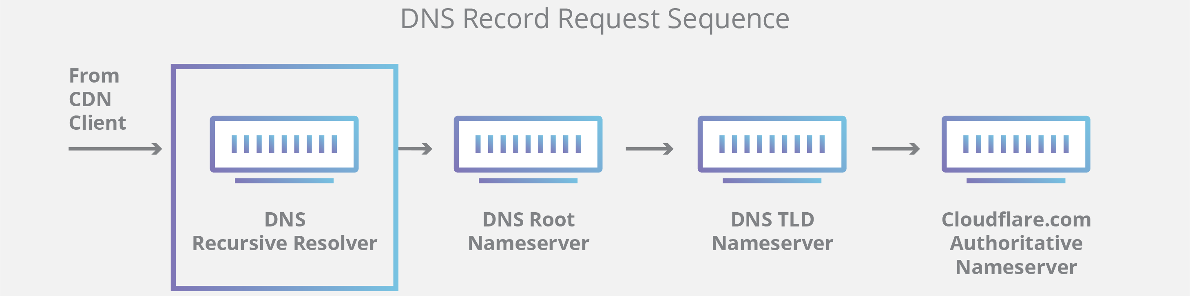
What's the difference between an authoritative DNS server and a recursive DNS resolver?
Both concepts refer to servers (groups of servers) that are integral to the DNS infrastructure, but each performs a different role and lives in different locations inside the pipeline of a DNS query. One way to think about the difference is the recursive resolver is at the beginning of the DNS query and the authoritative nameserver is at the end
.
Recursive DNS resolver
The recursive resolver is the computer that responds to a recursive request from a client and takes the time to track down the DNS record. It does this by making a series of requests until it reaches the authoritative DNS nameserver for the requested record (or times out or returns an error if no record is found). Luckily, recursive DNS resolvers do not always need to make multiple requests in order to track down the records needed to respond to a client; caching is a data persistence process that helps short-circuit the necessary requests by serving the requested resource record earlier in the DNS lookup.

Slide 10
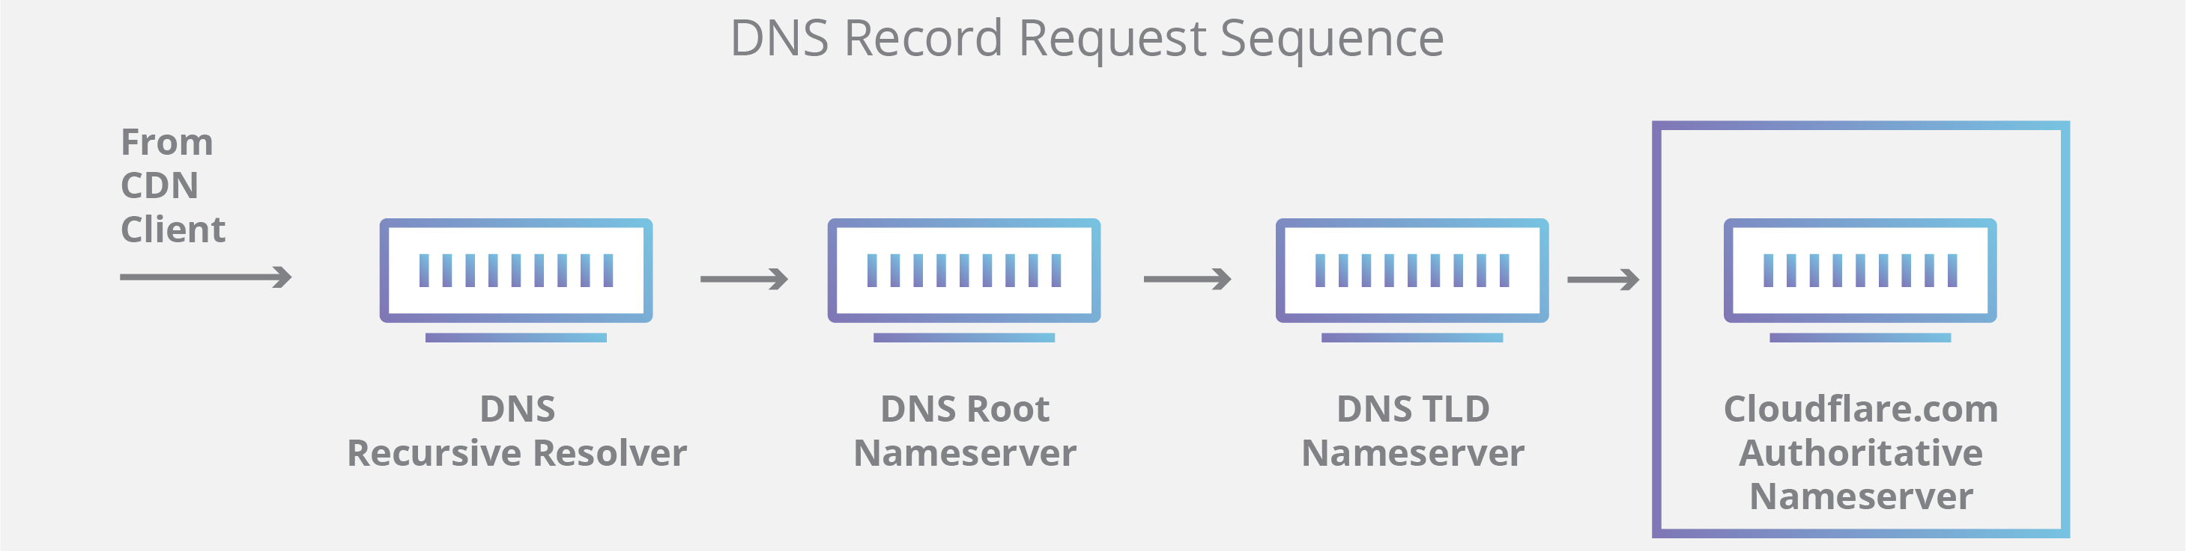
Authoritative DNS server
Put simply, an authoritative DNS server is a server that actually holds, and is responsible for, DNS resource records. This is the server at the bottom of the DNS lookup chain that will respond with the queried resource record, ultimately allowing the web browser making the request to reach the IP address needed to access a website or other web resources. An authoritative nameserver can satisfy queries from its own data without needing to query another source, as it is the final source of truth for certain DNS records.
It’s worth mentioning that in instances where the query is for a subdomain such as foo.example.com or blog.cloudflare.com, an additional nameserver will be added to the sequence after the authoritative nameserver, which is responsible for storing the subdomain’s CNAME record.

Slide 11
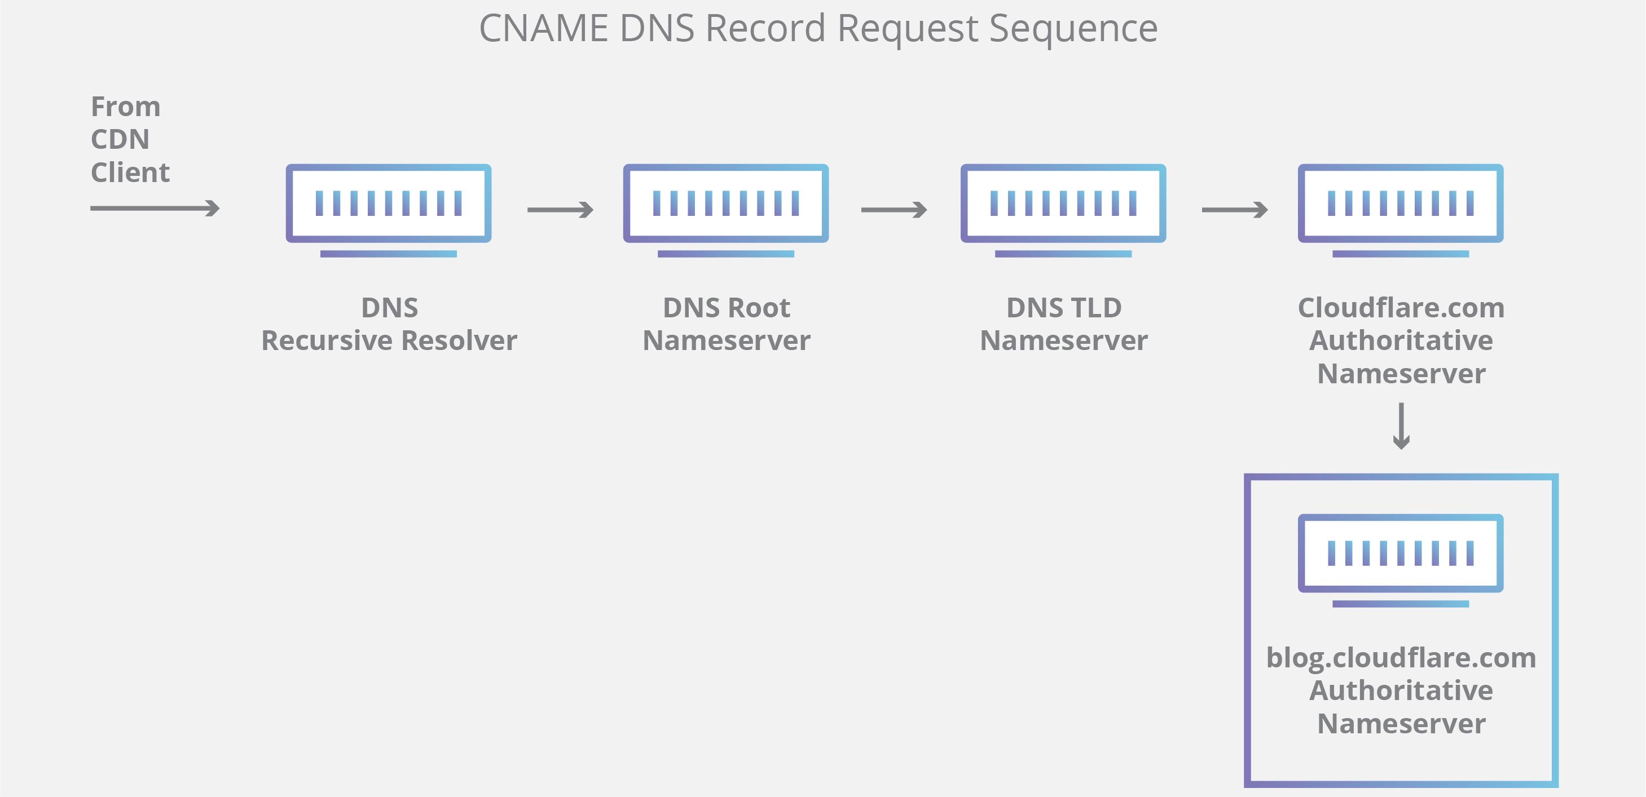
There is a key difference between many DNS services and the one that Cloudflare provides. Different DNS recursive resolvers such as Google DNS, OpenDNS, and providers like Comcast all maintain data center installations of DNS recursive resolvers. These resolvers allow for quick and easy queries through optimized clusters of DNS-optimized computer systems, but they are fundamentally different than the nameservers hosted by Cloudflare.
Cloudflare maintains infrastructure-level nameservers that are integral to the functioning of the Internet. One key example is the f-root server network which Cloudflare is partially responsible for hosting. The F-root is one of the root level DNS nameserver infrastructure components responsible for the billions of Internet requests per day. Our Anycast network puts us in a unique position to handle large volumes of DNS traffic without service interruption.

Slide 12
What are the steps in a DNS lookup?
For most situations, DNS is concerned with a domain name being translated into the appropriate IP address. To learn how this process works, it helps to follow the path of a DNS lookup as it travels from a web browser, through the DNS lookup process, and back again. Let's take a look at the steps.
Note: Often DNS lookup information will be cached either locally inside the querying computer or remotely in the DNS infrastructure. There are typically 8 steps in a DNS lookup. When DNS information is cached, steps are skipped from the DNS lookup process which makes it quicker. The example below outlines all 8 steps when nothing is cached.
The 8 steps in a DNS lookup:
A user types ‘example.com’ into a web browser and the query travels into the Internet and is received by a DNS recursive resolver.
The resolver then queries a DNS root nameserver (.).
The root server then responds to the resolver with the address of a Top Level Domain (TLD) DNS server (such as .com or .net), which stores the information for its domains. When searching for example.com, our request is pointed toward the .com TLD.
The resolver then makes a request to the .com TLD.
The TLD server then responds with the IP address of the domain’s nameserver, example.com.
Lastly, the recursive resolver sends a query to the domain’s nameserver.
The IP address for example.com is then returned to the resolver from the nameserver.
The DNS resolver then responds to the web browser with the IP address of the domain requested initially.
Once the 8 steps of the DNS lookup have returned the IP address for example.com, the browser is able to make the request for the web page:
The browser makes a HTTP request to the IP address.
The server at that IP returns the webpage to be rendered in the browser (step 10).

Slide 13
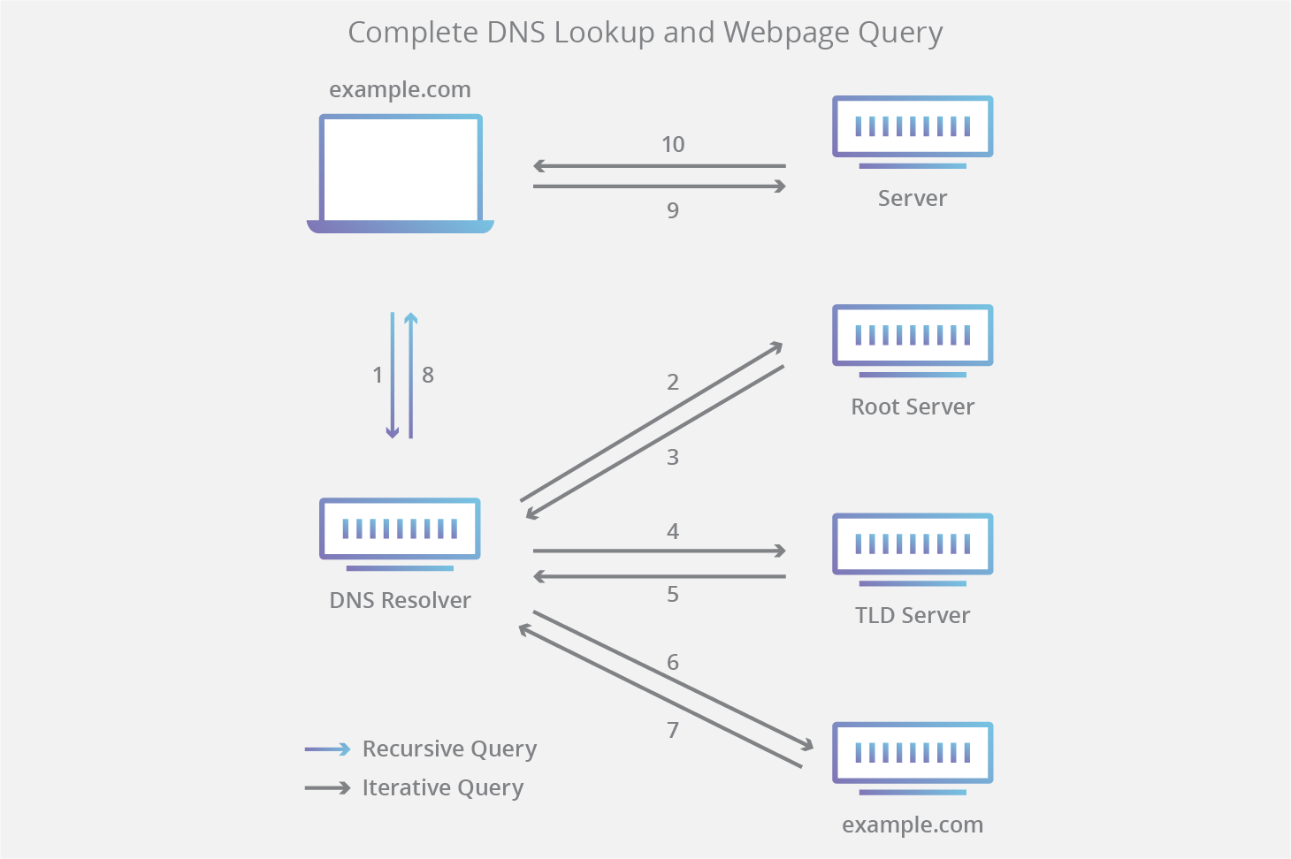

Slide 14
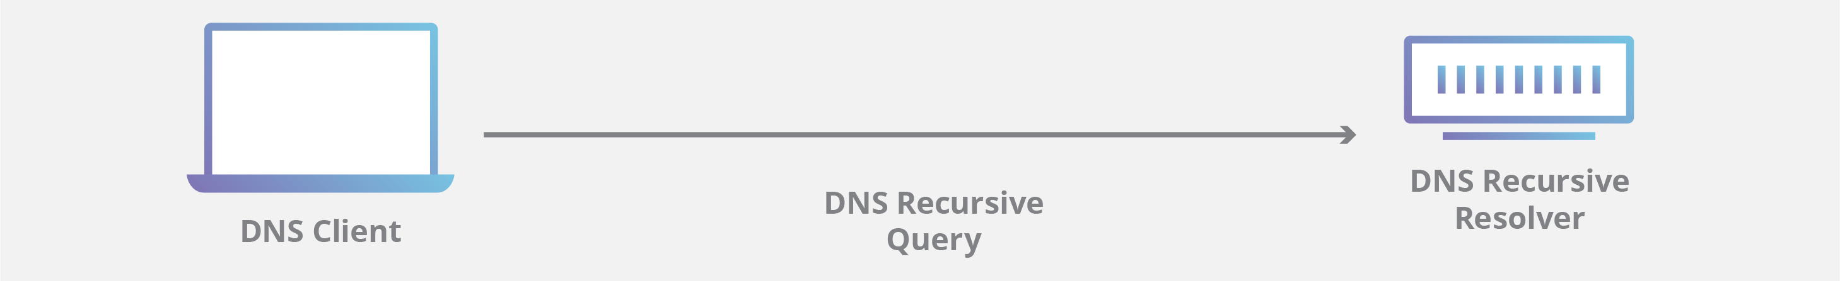
What is a DNS resolver?
The DNS resolver is the first stop in the DNS lookup, and it is responsible for dealing with the client that made the initial request. The resolver starts the sequence of queries that ultimately leads to a URL being translated into the necessary IP address.
Note: A typical uncached DNS lookup will involve both recursive and iterative queries.
It's important to differentiate between a recursive DNS query and a recursive DNS resolver. The query refers to the request made to a DNS resolver requiring the resolution of the query. A DNS recursive resolver is the computer that accepts a recursive query and processes the response by making the necessary requests.

Slide 15
What are the types of DNS Queries?
In a typical DNS lookup three types of queries occur. By using a combination of these queries, an optimized process for DNS resolution can result in a reduction of distance traveled. In an ideal situation cached record data will be available, allowing a DNS name server to return a non-recursive query.
3 types of DNS queries:
Recursive query - In a recursive query, a DNS client requires that a DNS server (typically a DNS recursive resolver) will respond to the client with either the requested resource record or an error message if the resolver can't find the record.
Iterative query - in this situation the DNS client will allow a DNS server to return the best answer it can. If the queried DNS server does not have a match for the query name, it will return a referral to a DNS server authoritative for a lower level of the domain namespace. The DNS client will then make a query to the referral address. This process continues with additional DNS servers down the query chain until either an error or timeout occurs.
Non-recursive query - typically this will occur when a DNS resolver client queries a DNS server for a record that it has access to either because it's authoritative for the record or the record exists inside of its cache. Typically, a DNS server will cache DNS records to prevent additional bandwidth consumption and load on upstream servers.

Slide 16
What is DNS caching? Where does DNS caching occur?
The purpose of caching is to temporarily stored data in a location that results in improvements in performance and reliability for data requests. DNS caching involves storing data closer to the requesting client so that the DNS query can be resolved earlier and additional queries further down the DNS lookup chain can be avoided, thereby improving load times and reducing bandwidth/CPU consumption. DNS data can be cached in a variety of locations, each of which will store DNS records for a set amount of time determined by a time-to-live (TTL).
Browser DNS caching
Modern web browsers are designed by default to cache DNS records for a set amount of time. the purpose here is obvious; the closer the DNS caching occurs to the web browser, the fewer processing steps must be taken in order to check the cache and make the correct requests to an IP address. When a request is made for a DNS record, the browser cache is the first location checked for the requested record.
In chrome, you can see the status of your DNS cache by going to chrome://net-internals/#dns.
Operating system (OS) level DNS caching
The operating system level DNS resolver is the second and last local stop before a DNS query leaves your machine. The process inside your operating system that is designed to handle this query is commonly called a “stub resolver” or DNS client. When a stub resolver gets a request from an application, it first checks its own cache to see if it has the record. If it does not, it then sends a DNS query (with a recursive flag set), outside the local network to a DNS recursive resolver inside the Internet service provider (ISP).
When the recursive resolver inside the ISP receives a DNS query, like all previous steps, it will also check to see if the requested host-to-IP-address translation is already stored inside its local persistence layer.

Slide 17
The recursive resolver also has additional functionality depending on the types of records it has in its cache:
If the resolver does not have the A records, but does have the NS records for the authoritative nameservers, it will query those name servers directly, bypassing several steps in the DNS query. This shortcut prevents lookups from the root and .com nameservers (in our search for example.com) and helps the resolution of the DNS query occur more quickly.
If the resolver does not have the NS records, it will send a query to the TLD servers (.com in our case), skipping the root server.
In the unlikely event that the resolver does not have records pointing to the TLD servers, it will then query the root servers. This event typically occurs after a DNS cache has been purged.

Slide 18
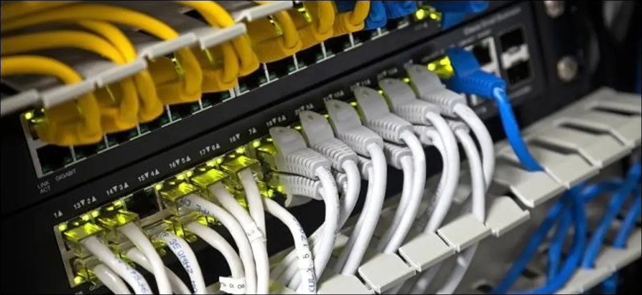
TCP AND UDP PROTOCOLS
You’ve probably seen references to TCP and UDP when setting up port-forwarding on a router or when configuring firewall software. These two protocols are used for different types of data.
TCP/IP is a suite of protocols used by devices to communicate over the Internet and most local networks. It is named after two of it’s original protocols—the Transmission Control Protocol (TCP) and the Internet Protocol (IP). TCP provides apps a way to deliver (and receive) an ordered and error-checked stream of information packets over the network. The User Datagram Protocol (UDP) is used by apps to deliver a faster stream of information by doing away with error-checking. When configuring some network hardware or software, you may need to know the difference.

Slide 19
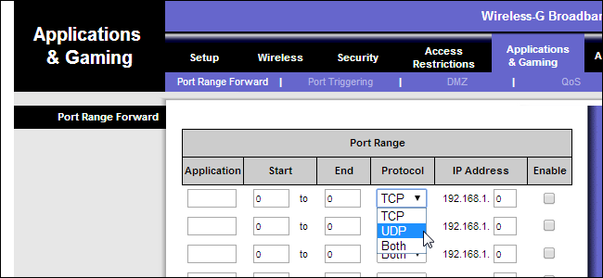
What They Have In Common
Both TCP and UDP are protocols used for sending bits of data—known as packets—over the Internet. Both protocols build on top of the IP protocol. In other words, whether you’re sending a packet via TCP or UDP, that packet is sent to an IP address. These packets are treated similarly, as they’re forwarded from your computer to intermediary routers and on to the destination. TCP and UDP aren’t the only protocols that work on top of IP. However, they are the most widely used.

Slide 20
How TCP Works
TCP is the most commonly used protocol on the Internet.
When you request a web page in your browser, your computer sends TCP packets to the web server’s address, asking it to send the web page back to you. The web server responds by sending a stream of TCP packets, which your web browser stitches together to form the web page. When you click a link, sign in, post a comment, or do anything else, your web browser sends TCP packets to the server and the server sends TCP packets back.
TCP is all about reliability—packets sent with TCP are tracked so no data is lost or corrupted in transit. This is why file downloads don’t become corrupted even if there are network hiccups. Of course, if the recipient is completely offline, your computer will give up and you’ll see an error message saying it can’t communicate with the remote host.
TCP achieves this in two ways. First, it orders packets by numbering them. Second, it error-checks by having the recipient send a response back to the sender saying that it has received the message. If the sender doesn’t get a correct response, it can resend the packets to ensure the recipient receives them correctly.
Process Explorer and other system utilities can show the type of connections a process makes—here we can see the Chrome browser with open TCP connections to a variety of web servers.

Slide 21
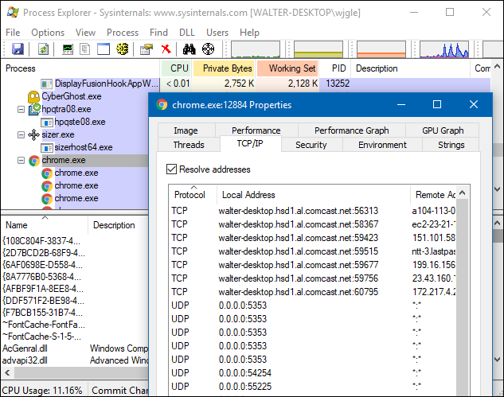

Slide 22
How UDP Works
The UDP protocol works similarly to TCP, but it throws out all the error-checking stuff. All the back-and-forth communication introduce latency, slowing things down.
When an app uses UDP, packets are just sent to the recipient. The sender doesn’t wait to make sure the recipient received the packet—it just continues sending the next packets. If the recipient misses a few UDP packets here and there, they are just lost—the sender won’t resend them. Losing all this overhead means the devices can communicate more quickly.
UDP is used when speed is desirable and error correction isn’t necessary. For example, UDP is frequently used for live broadcasts and online games.
For example, let’s say you’re watching a live video stream, which are often broadcast using UDP instead of TCP. The server just sends a constant stream of UDP packets to computers watching. If you lose your connection for a few seconds, the video may freeze or get jumpy for a moment and then skip to the current bit of the broadcast. If you experience minor packet-loss, the video or audio may be distorted for a moment as the video continues to play without the missing data.
This works similarly in online games. If you miss some UDP packets, player characters may appear to teleport across the map as you receive the newer UDP packets. There’s no point in requesting the old packets if you missed them, as the game is continuing without you. All that matters is what’s happening right now on the game server—not what happened a few seconds ago. Ditching TCP’s error correction helps speed up the game connection and reduce latency.

Slide 23
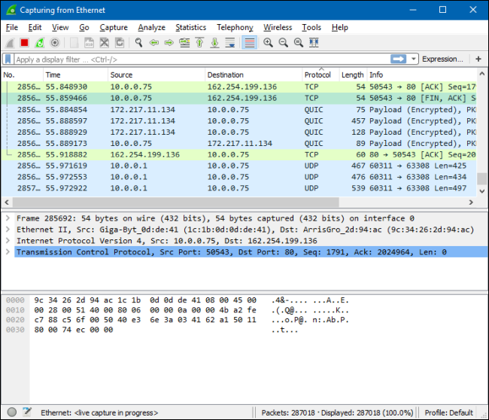
So What?
Whether an application uses TCP or UDP is up to its developer, and the choice depends on what an application needs. Most apps need the error-correction and robustness of TCP, but some applications need the speed and reduced overhead of UDP. If you fire a network analysis tool like Wireshark, you can see the different types of packets travelling back and forth.
Unless you’re a network administrator or software developer, this shouldn’t doesn’t affect you too much. If you’re configuring your router or firewall software and you’re not sure whether an application uses TCP or UDP, you can generally select the “Both” option to have your router or firewall apply the same rule to both TCP and UDP traffic.

Slide 24
Difference Between TCP and UDP
TCP and UDP: What is the Difference Between TCP and UDP?
Both of these are connection protocols. Out of these two, TCP is a connection-oriented one while the UDP is connectionless. A major difference between them is their speed. UDP is much faster than TCP. It has a much more effective protocol because it is simpler and faster. On the other hand, TCP allows retransmission of data packets (lost ones)- something that the UDP doesn’t offer. Another major difference between TCP and UDP is that UDP does not work on end-to-end communications. Conversely, TCP delivers data in the intended order to the server from the user (and vice versa). In fact, UDP also does not check a receiver’s readiness.
Before we discover the difference between TCP and UDP in further detail, let us know a bit more about them.
What is TCP?
TCP is an abbreviation for Transmission Control Protocol. It is a connection-oriented protocol. It means that after establishing a stable connection, one can easily transmit data in two directions. TCP comes with built-in systems. They help in checking errors and guarantee the delivery of data in the same order of sending. Thus, TCP is the perfect protocol for transferring information like data files, images, web pages, and more.
While this protocol is inherently reliable, the feedback mechanisms working with it also result in a larger overhead. It translates to greater use of the bandwidth available in your network.
What is UDP?
UDP is an abbreviation for User Datagram Protocol. It is a connectionless, simple Internet protocol that requires no recovery and error-checking services. The use of UDP causes zero overhead for opening, maintaining, or terminating any connection. It sends data continuously to any recipient, irrespective of whether they receive it or not.
UDP isn’t an ideal protocol for viewing a webpage, sending an email, or downloading any file. But one can largely prefer it in cases of real-time communications such as broadcasts or multi-task network transmission.

Slide 25
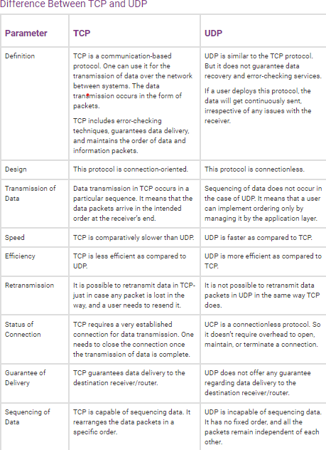
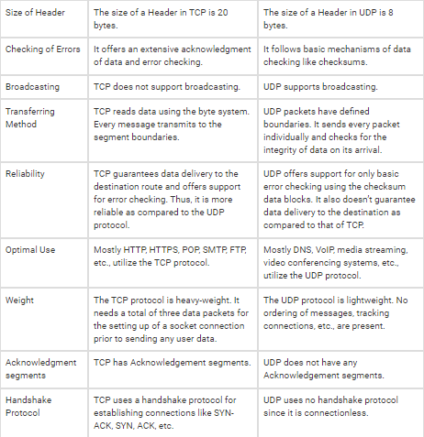

Slide 26
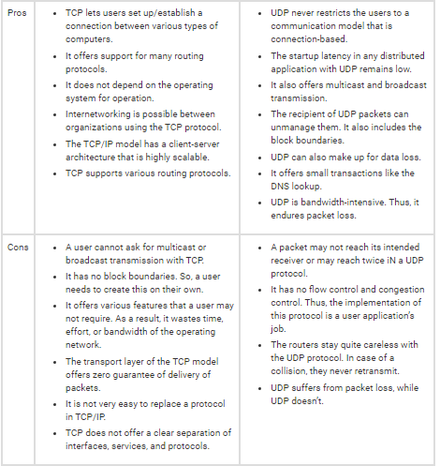

Slide 27
System status check and instance status check.
Types of status checks
There are two types of status checks: system status checks and instance status checks.
System status checks
System status checks monitor the AWS systems on which your instance runs. These checks detect underlying problems with your instance that require AWS involvement to repair. When a system status check fails, you can choose to wait for AWS to fix the issue, or you can resolve it yourself. For instances backed by Amazon EBS, you can stop and start the instance yourself, which in most cases results in the instance being migrated to a new host. For Linux instances backed by instance store, you can terminate and replace the instance. For Windows instances, the root volume must be an Amazon EBS volume; instance store is not supported for the root volume. Note that instance store volumes are ephemeral and all data is lost when the instance is stopped.
The following are examples of problems that can cause system status checks to fail:
Loss of network connectivity
Loss of system power
Software issues on the physical host
Hardware issues on the physical host that impact network reachability
Instance status checks
Instance status checks monitor the software and network configuration of your individual instance. Amazon EC2 checks the health of the instance by sending an address resolution protocol (ARP) request to the network interface (NIC). These checks detect problems that require your involvement to repair. When an instance status check fails, you typically must address the problem yourself (for example, by rebooting the instance or by making instance configuration changes).
The following are examples of problems that can cause instance status checks to fail:
Failed system status checks
Incorrect networking or startup configuration
Exhausted memory
Corrupted file system
Incompatible kernel

Slide 28
Port numbers.
What is a port number?
A port number is a way to identify a specific process to which an internet or other network message is to be forwarded when it arrives at a server. All network-connected devices come equipped with standardized ports that have an assigned number. These numbers are reserved for certain protocols and their associated function. Hypertext Transfer Protocol (HTTP) messages, for example, always go to port 80 -- one of the most commonly used ports.
Developers of the Advanced Research Projects Agency Network, an informal cooperation of system administrators and software authors, proposed the concept of port numbers. Once known as socket numbers, the early incarnation of port numbers is similar to the Internet Protocol (IP) address class used today.
What is the difference between an IP address and a port number?
An IP address identifies a machine in an IP network and is used to determine the destination of a data packet. Port numbers identify a particular application or service on a system. An IP address is a logical address used to identify a device on the network. Any device connected to the internet is assigned a unique IP address for identification. This identifying information enables devices to communicate over the internet.
Port numbers are part of the addressing information that helps identify senders and receivers of information and a particular application on the devices. Port numbers consist of 16-bit numbers.
For example, a user request for a file transfer from a client, or local host, to a remote server on the internet uses File Transfer Protocol (FTP) for the transaction. Both devices must be configured to transfer files via FTP. To transfer the file, the Transmission Control Protocol (TCP) software layer in local host identifies the port number of 21, which, by convention, associates with an FTP request -- in the 16-bit port number integer that is appended to the request.
At the server, the TCP layer will read port number 21 and forward the request to the FTP program at the server.

Slide 29
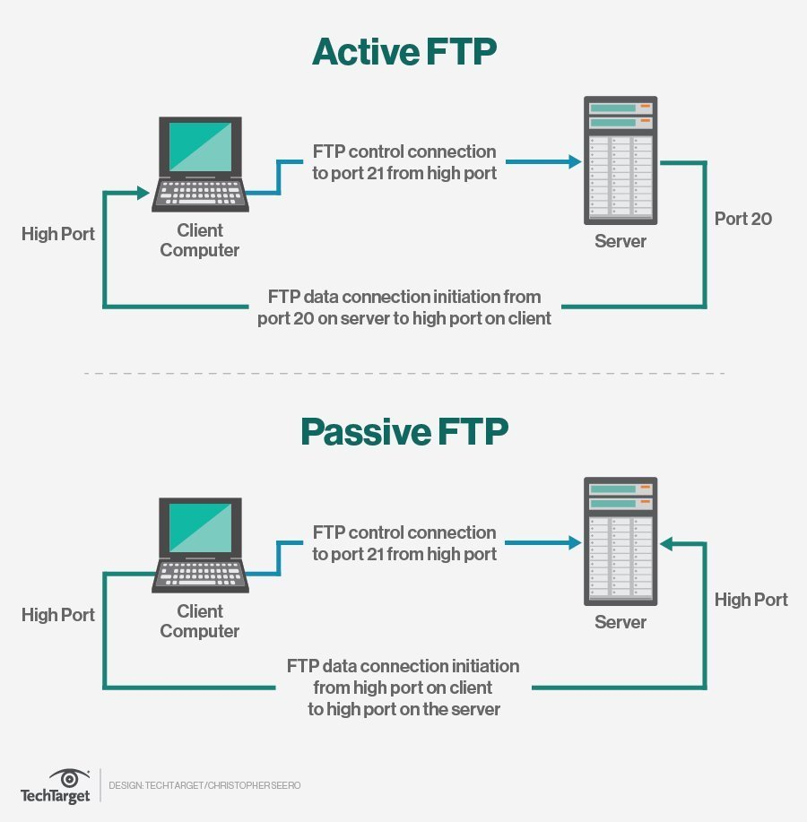

Slide 30
What are the different types of port numbers and their uses?
There are 65,535 port numbers, but not all are used every day.
Restricted port numbers or well-known port numbers are reserved by prominent companies and range from 0 to 1023. Apple QuickTime, Structured Query Language services and Gopher services use some of these restricted ports.
Those who want to register a specific port number can choose from 1024 to 49151. Software companies typically register these port numbers. Dynamic or private ports ranging from 49152 to 65536 are available for anyone to use.
In another scenario, a port number is assigned temporarily -- for the duration of the request and its completion -- from a range of assigned port numbers. This is called a temporary port number.
Here are some commonly used ports and their associated networking protocols:
Ports 20 and 21. FTP is used to transfer files between a client and a server.
Port 22. Secure Shell is one of several tunneling protocols used to build secure network connections.
Port 25. Simple Mail Transfer Protocol (SMTP) is commonly used for email.
Port 53. Domain name system (DNS) is a critical process that matches human-readable domain names to machine-readable IP addresses on the modern internet. It helps users load websites and applications without typing in a long list of IP addresses.
Port 80. HTTP is the protocol that enables the World Wide Web.
Port 123. Network Time Protocol helps computer clocks sync with each other. It's a vital process in encryption
Port 179. Border Gateway Protocol (BGP) helps establish efficient routes between the large networks or autonomous systems that make up the internet. These large networks use BGP to broadcast which IP addresses they control.
Port 443. HTTP Secure (HTTPS) is like HTTP but more secure. All HTTPS web traffic goes straight to port 443. Any network service that uses HTTPS for encryption, such as DNS over HTTPS, also connects directly to this port.
Port 500. Internet Security Association and Key Management Protocol helps set up secure IP Security
Port 3389. Remote Desktop Protocol enables users to connect to their desktop computers from another device remotely.

